Slide 1
JAMIE DOMM - JDIM.DIGITAL
Optimizing Your Ministry’s YouTube Channel for Evangelism

Slide 2
Outline
YouTube for Ministry
Getting started
Know your audience review
How to get found on YouTube
10 tips for optimization videos
Improve your curb appeal
Q&A

Slide 3
Video is King!
Internet video traffic accounts for 80% of all consumer Internet traffic.

Slide 4
WHAT'S NEEDED:
Communication skills: being able to communicate an idea clearly and efficiently is key
Elementary video editing skills: being able to cut out errors or splice together footage is easily learned
Video editing software: free software is more than sufficient, such as Windows Movie Maker for PC and iMovie for Mac
Basic design skills: I recommend Canva that makes design easy with ready-made templates, graphics, and stock images.
Expert knowledge of your target audience: How can you help them? What are their pain points and felt needs?
Don't know how to do something, YouTube or Google it!
What you need to get started...it's okay to learn as you go!

Slide 5
KNOW YOUR AUDIENCE: MARKETING RULE OF THUMB
If you try to reach everyone
all the time, you'll end up
REACHING NO ONE.

Slide 6
Reminder: It is vital to understand who your audience is before you create content.

Slide 7
Create deep connections by identifying with
CORE VALUES, NEEDS, & COMMON EXPERIENCES.
Help people solve problems and live life better to
create loyalty to your ministry.
Download the worksheet: JDIM.digital/publications

Slide 8
How to get found on YouTube

Slide 9
Begin with the felt needs of your target audience.
A BIBLICAL MODEL
Jesus sought first to fulfill people’s needs; He then invited them to follow.
Make a list of key phrases, focusing primarily on the strongest and niche topics related to the needs of your target audience.

Slide 10
Create Content Your Target Audience
is Actually Searching For
Make their felt needs your priority & inspiration.
Create content related to top YouTube searches related to relevant topics.

Slide 11
Next, use the language they use.
How are they searching?
What words do they use?
GET CREATIVE & SPECIFIC

Slide 12
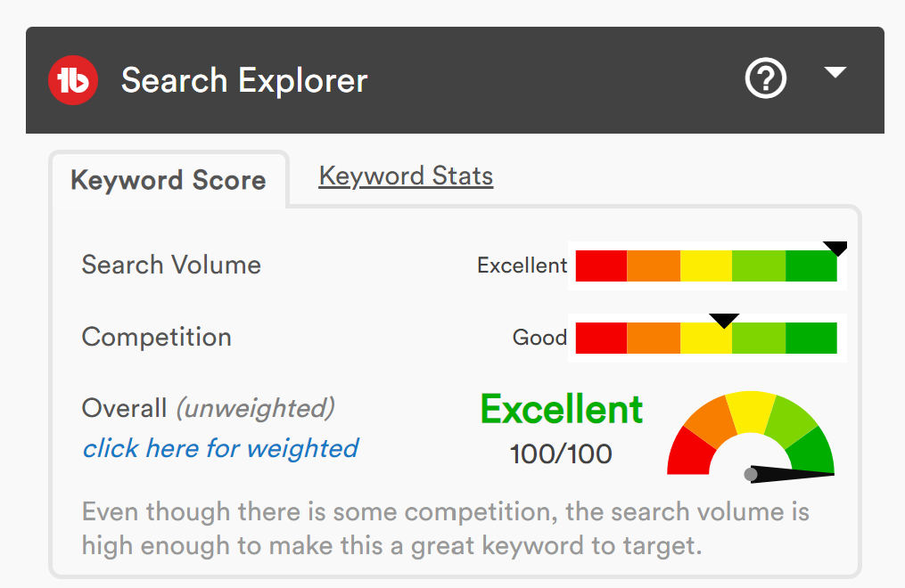
Recommended Tool:
TubeBuddy.com
A great (and easy to use) resource to help you identify good titles and tags based on search volume and competition.
To Seek and To Save -> Does Jesus want a relationship with me again?

Slide 13
Next: The Ten Guidelines for Video Missions

Slide 14
#1 - EXTRACT THE MESSAGE
Livestreams are for your established community.
Repost just the message to create evangelistic content with evergreen value that can minister to seekers indefinitely.
Get creative, you can extract the children's stories too and other short snippets that have lasting value.

Slide 15
Will my audience still care about what is covered in this video regardless of when they view it?
If I was a part of my audience, would I spend time watching it?
Questions to consider:
Is the content in easy-to-digest segments that my audience can view on the go?
Does this video address a common question or solve a problem?

Slide 16
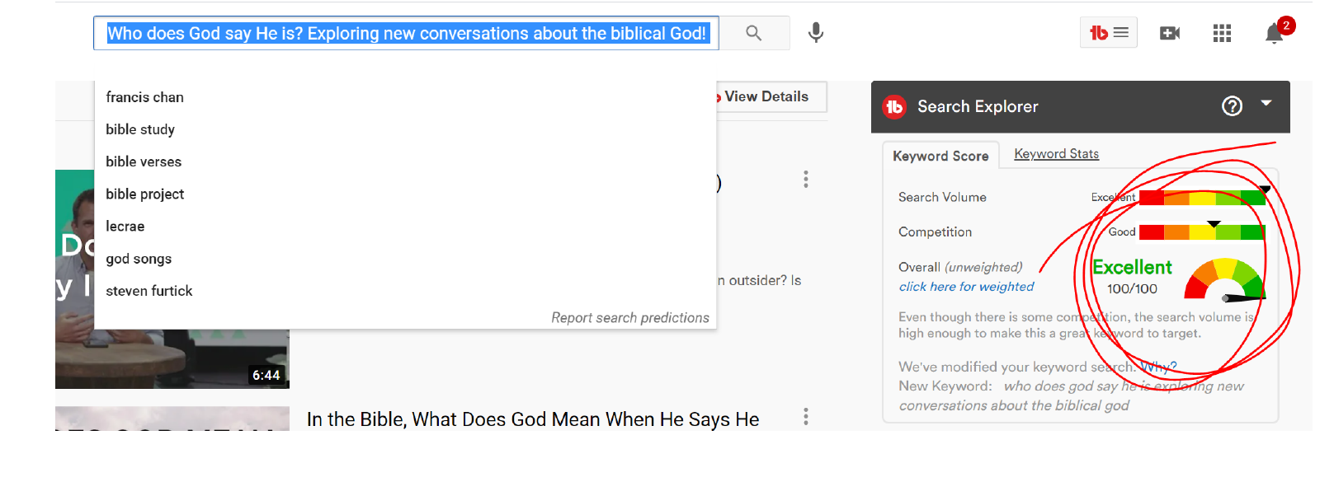
#2 - OPTIMIZE THE TITLE OF YOUR MESSAGE FOR SEARCH

Slide 17
TITLE CHECKLIST
□ Model your title after search phrases.
□ Pay attention to trends related to your topic.
□ Craft a title that piques curiosity.
□ Avoid dates and numbering systems.

Slide 18
#3 - ADD TITLE & DISCRIPTION
In the title field
Copy the title as the first sentence in the description

Slide 19
DISCRIPTION BOX CHECKLIST
□ Add title in the description box
□ Add speaker’s name
□ Add timestamps for easy navigation of longer videos (you need at least three)
□ Add video/topic/series/speaker information and backlinks
□ Add hashtags
□ Add social media information and links
□ Add general church or ministry information and links

Slide 20
example

Slide 21
#4 - CREATE AN EYE-CATCHING THUMBNAIL

Slide 22
Choose an image and/or graphics that stand out and pique curiosity.
Include large-font text that teases a value or a story.
Include close-ups of people’s faces. Viewers should be able to see the whites of their eyes on a mobile device.
Elements of a great thumbnail
Vary the thumbnails from picture to picture. Can use stock images
Use Canva.com to create a standard template for video thumbnails that reflects your ministry’s brand.
Incorporate your branding and logo.
Make sure the thumbnail is easy to understand on a small screen.
Add extra contrast, saturation, and sharpness.

Slide 23
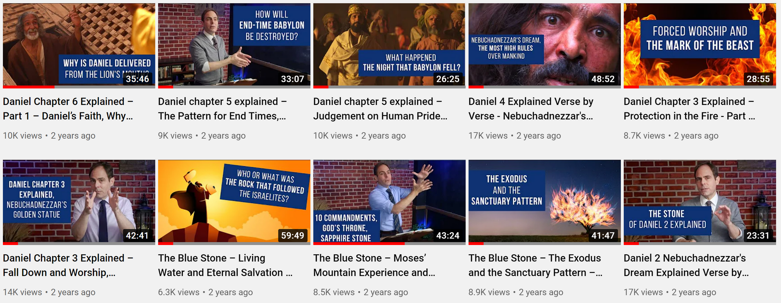

Slide 24
#5 - ADD THE VIDEO TO A PLAYLIST
Organize your channel by speakers, topics and series

Slide 25
#6 - MAXIMIZE YOUR USE OF RELEVANT TAGS

Slide 26
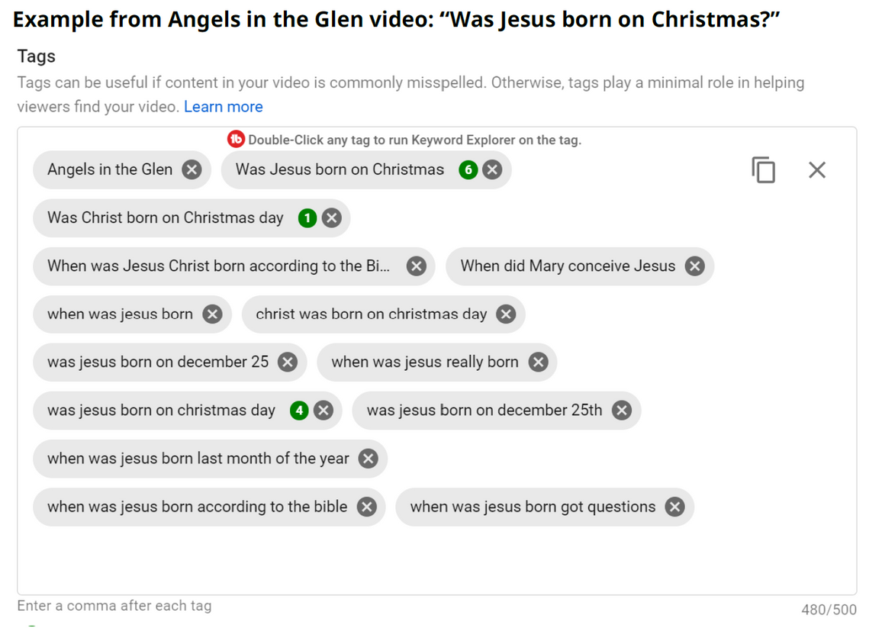
Tag checklist:
□ Your unique channel tag (example: Angels in the Glen) If the video is part of a series, you may also want to create a unique series tag.
□ Name of speaker if applicable
□ Title (tags should include the exact title of your video)
□ Four- to five-word search phrases related to the video
□ Variations on your search phrases (including commonly misspelled keywords)
□ Avoid random tags and one- or two-word tags.
□ Don’t use misleading keywords.

Slide 27
#7 - CHOOSE END SCREEN OPTIONS
□ Add a subscribe to the channel call-out
□ Add a playlist call-out or a video call-out
□ If possible, add a link to your website. (Members of the YouTube partners program have this option.)

Slide 29
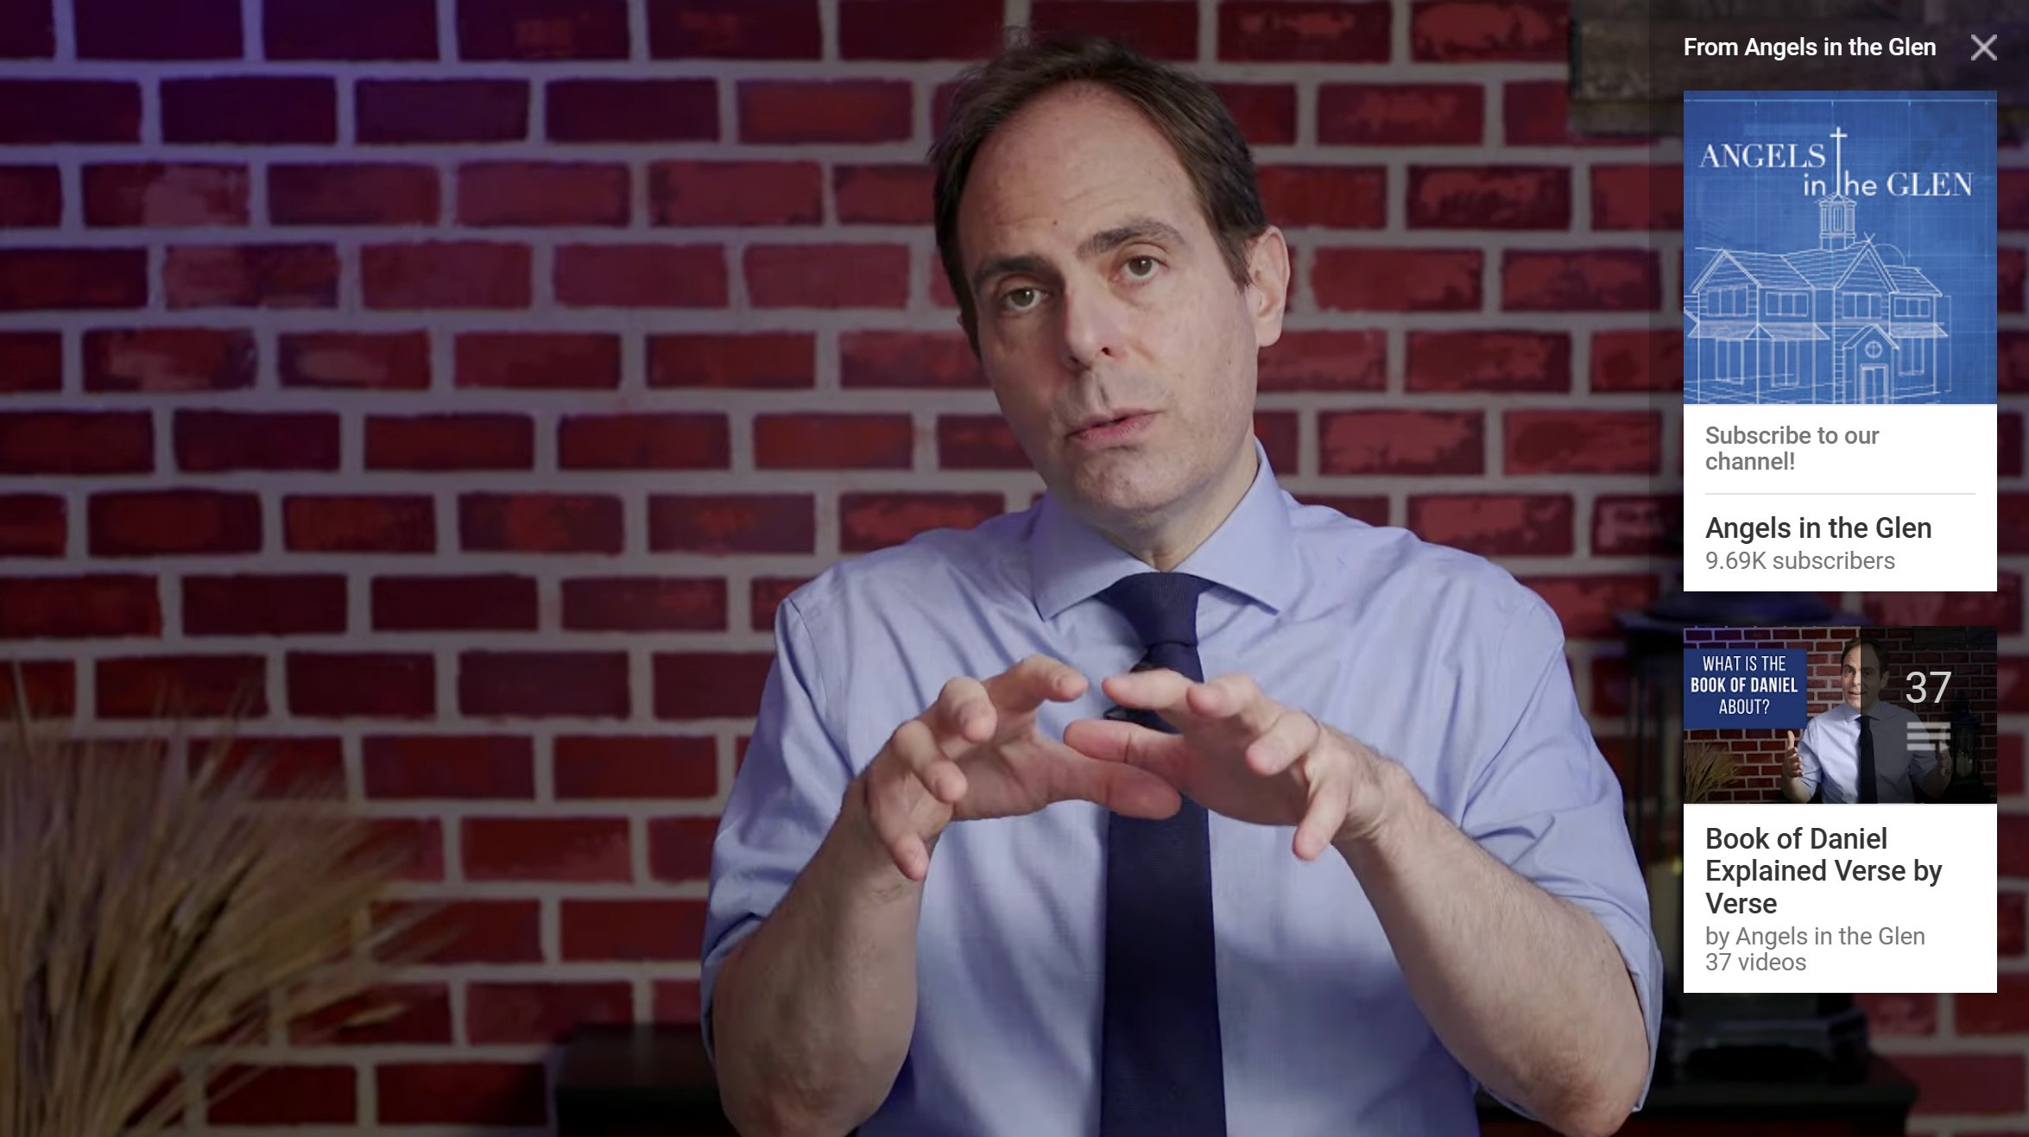
#8 - ADD AT LEAST ONE CARD
Cards appear as callouts
within the video.

Slide 30
#9 - PIN A COMMENT

Slide 31
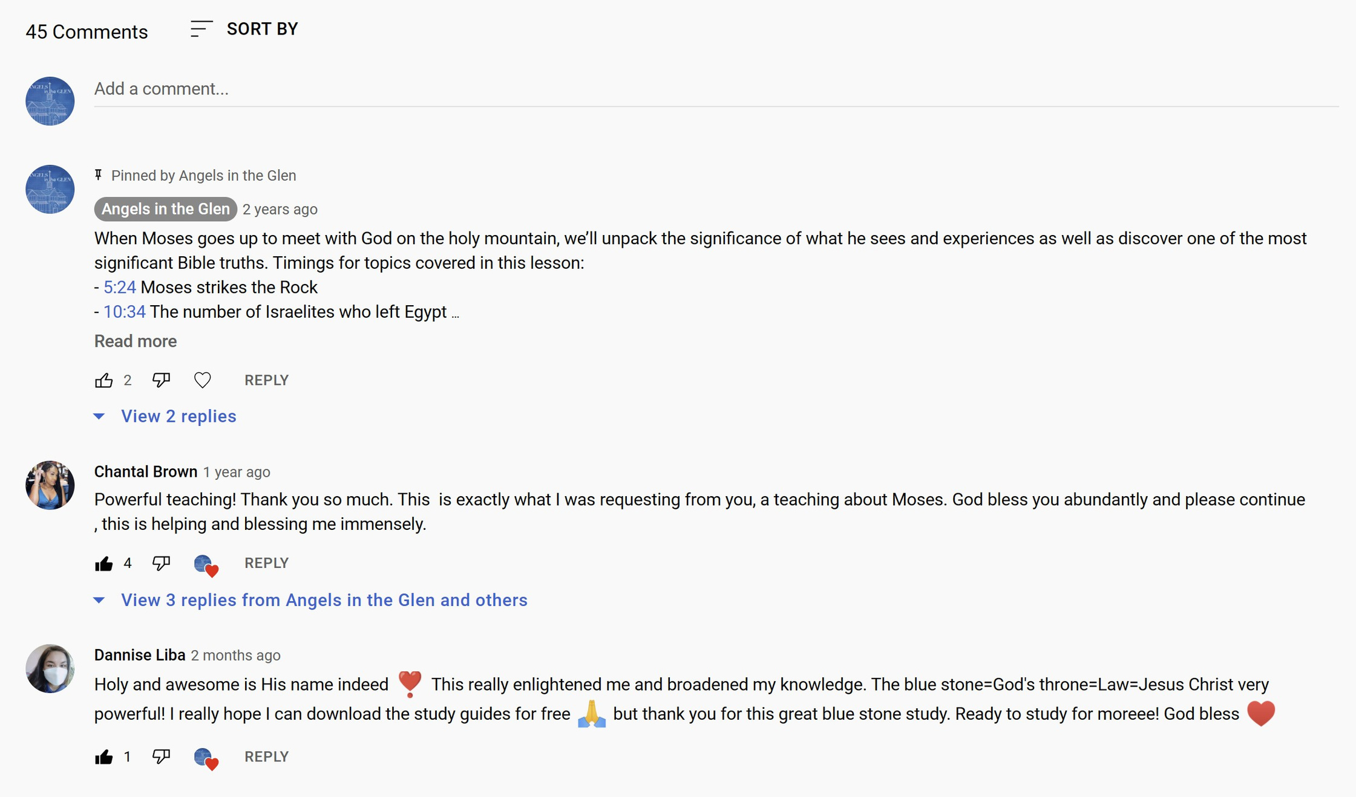

Slide 32
#10 - ENGAGE WITH COMMENTS
Don’t just talk at your audience; talk with them.

Slide 33
TIPS FOR GROWING COMMUNTIY
□ Heart comments
□ Reply to all comments
□ Thumbs up/down comments
□ Invite people to your website
□ Collect email addresses

Slide 34
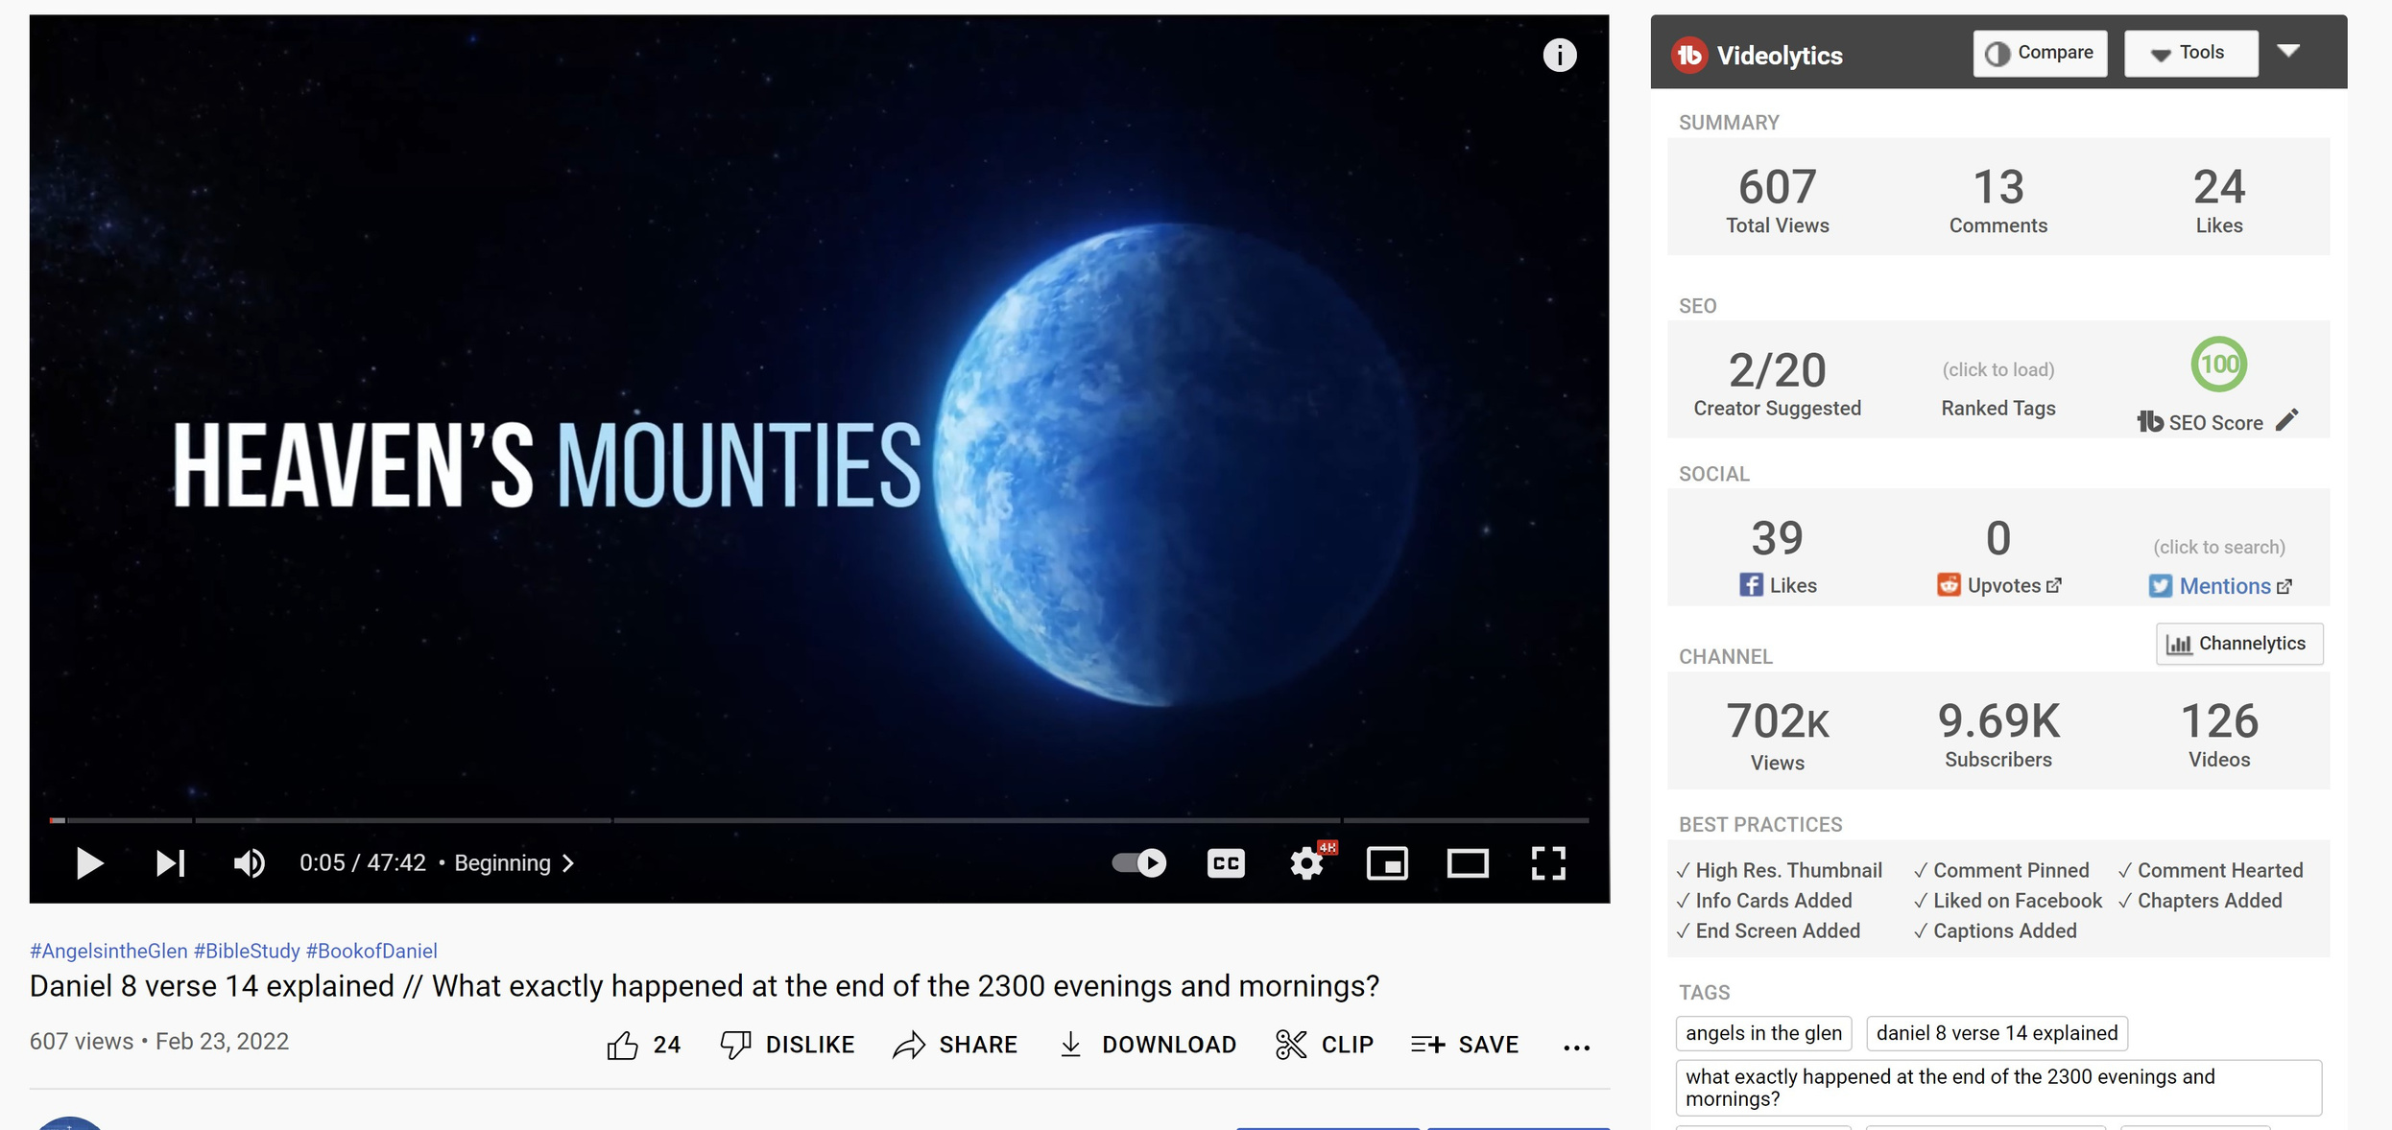
FOLLOW THESE GUIDELINES AND GET HIGH SEO SCORES

Slide 35
ELEMENTS OF A STRONG DIGITAL CURB APPEAL ON YOUTUBE

Slide 36
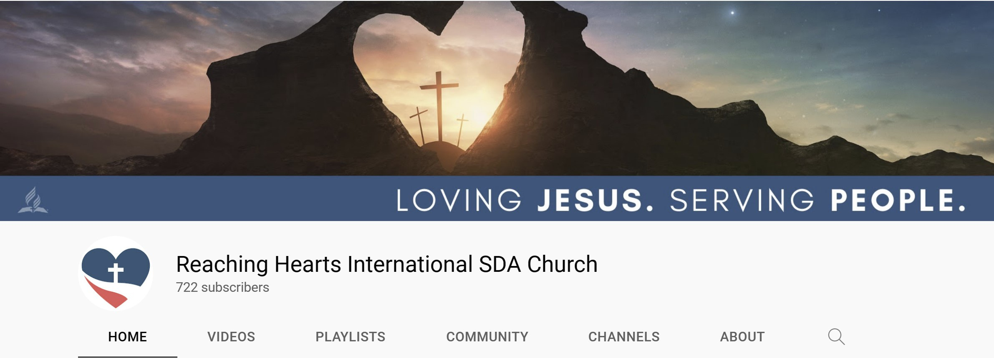
#1 - PROFILE IMAGE

Slide 37
#2 - HIGH RES & EYE CATCHING HEADER IMAGE

Slide 38
#3 - COMPLETE THE DESCRIPTION SECTION
Church example:

Slide 39
The description should include:
□ A call-out to your target audience
□ The unique value of your channel (UVP)
□ What your channel is about
□ What they should expect from your channel
□ Posting schedule

Slide 40
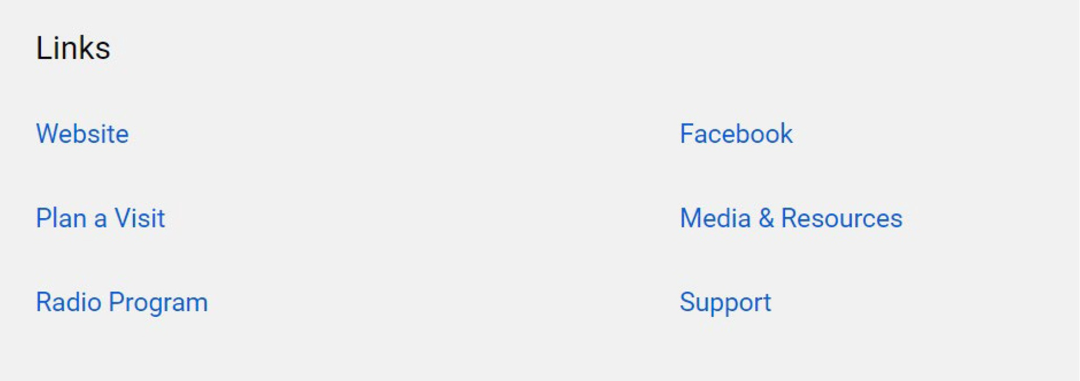
#4 - INCLUDE LINKS
Church example:

Slide 41
Choose at least 1 link to show in your channel header

Slide 42
#5 - THOUGHTFULLY ARRANGE YOUR
HOMEPAGE VIDEOS

Slide 43
#6 - CREATE A CHANNEL TRAILER
speaks directly new people
shares what your channel is about or what your goal is
how often they can expect new content
what kind of content they can expect

Slide 44
SDADATA.ORG
JDIM.DIGITAL
FOR FREE RESOURCES

Slide 45
The Digital Discipleship & Evangelism Guide
Available in Print & Digital Formats
AdventSource & Amazon
JDIM.digital/book

Slide 46
Q&A

